Slide 1
Modelling Children’s Development of Modal Thought
Collective Undergraduate Research Experience (CURE)’s Inaugural Flash Talk
University of Toronto
Dominic Le
CURE Advisor

Slide 2

Modal Thought ~ “Thinking about possibilities”
▢
“Their cat might like me”
“Smoking definitely causes cancer”
“I could go study”
“He must have forgotten”
♢
Notes:
Modal thought = thinking about possibilities
Real life involves thinking about possibilities so in order to accurate model thoughts we should be able to model how think about uncertain events

Slide 3


Components of Modal Thought
Logic
?
Memory
Simulation
Simulation Mindset (Rafetseder et al., 2013)
Notes:
First let’s identify some core components of thinking about possibilities

Slide 4
Children’s Milestones of Modal Thought

Slide 5
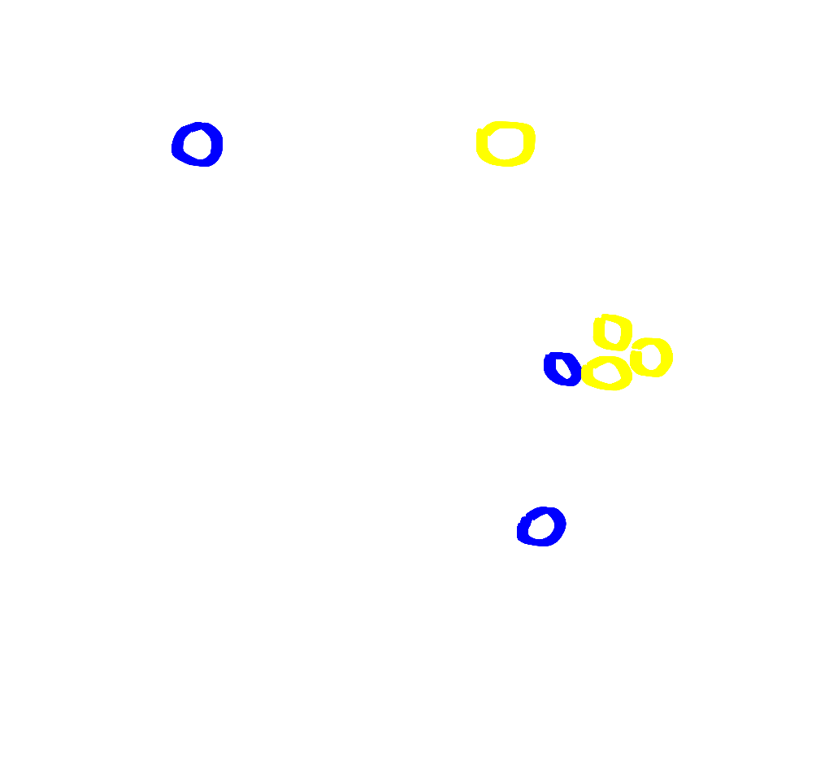

Multiple possibilities at 1 years
(Telegas et al., 2007)

Slide 6
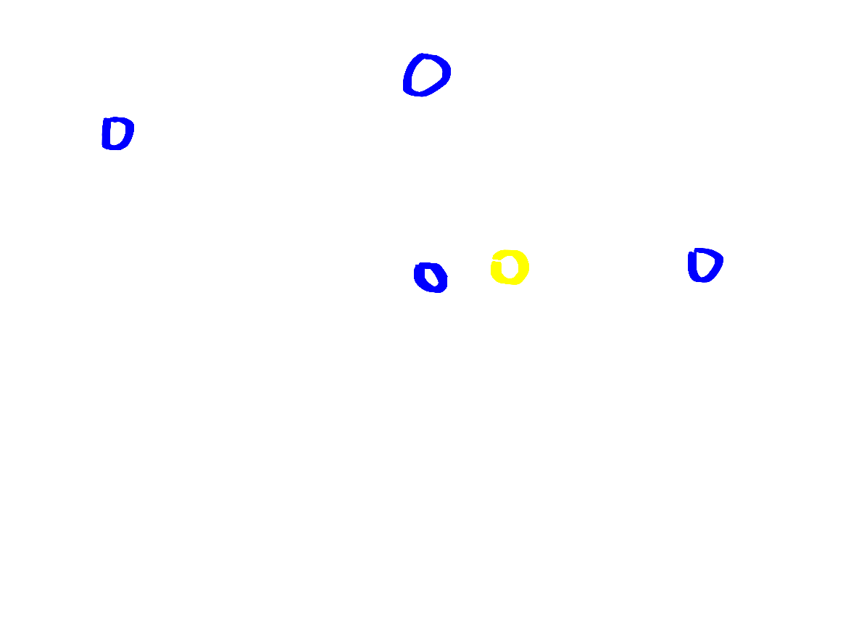
Branching possibilities at 2.5 years
(Alderate and Xu, 2023)

Slide 7
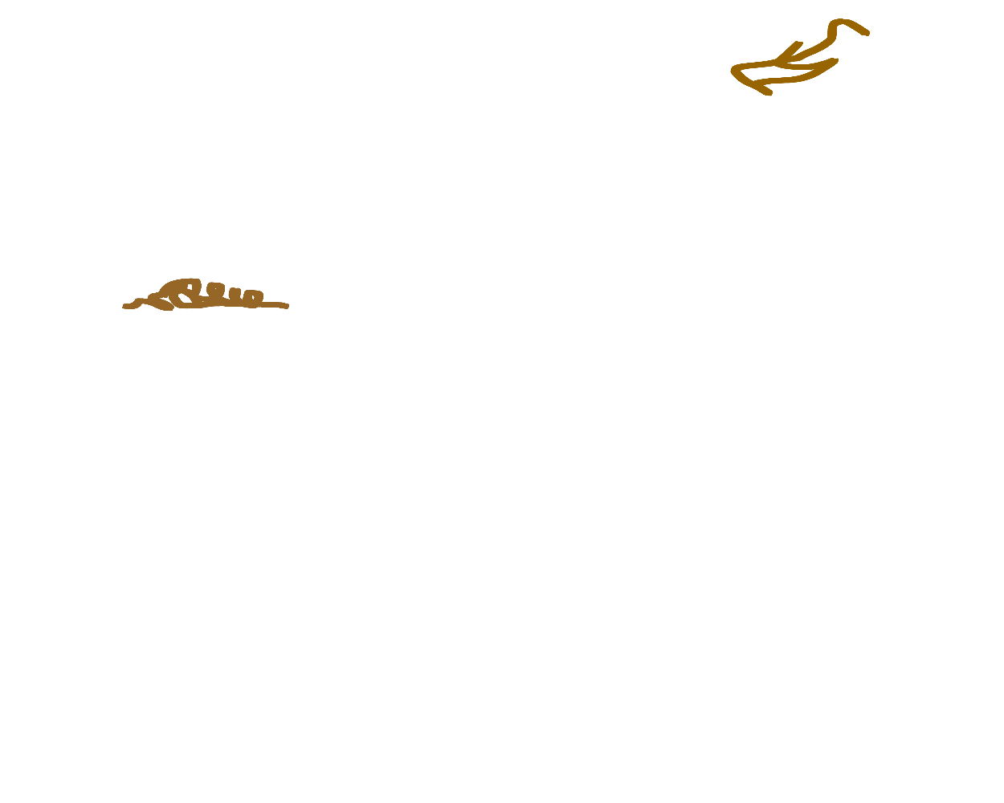
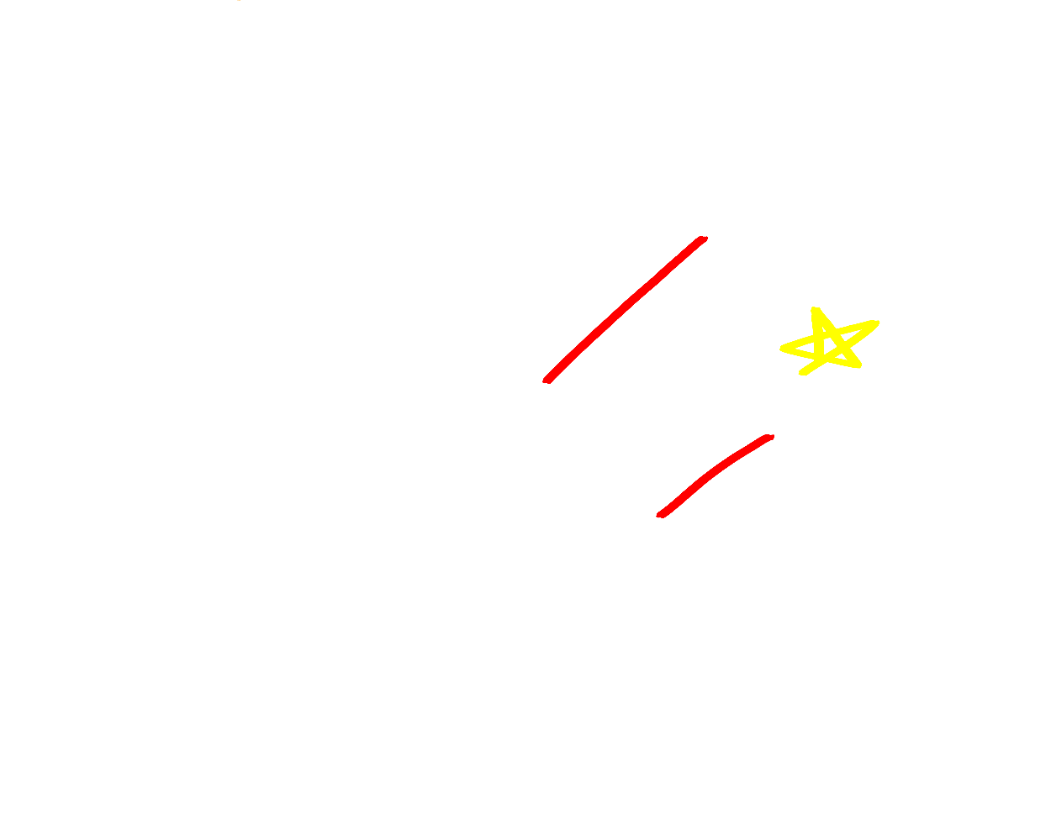
Logical negation at 2.5 years
Counterfactual negation at 3.5 years
Grigoroglou et al. (2019)
Harris et al. (1996)

Slide 8

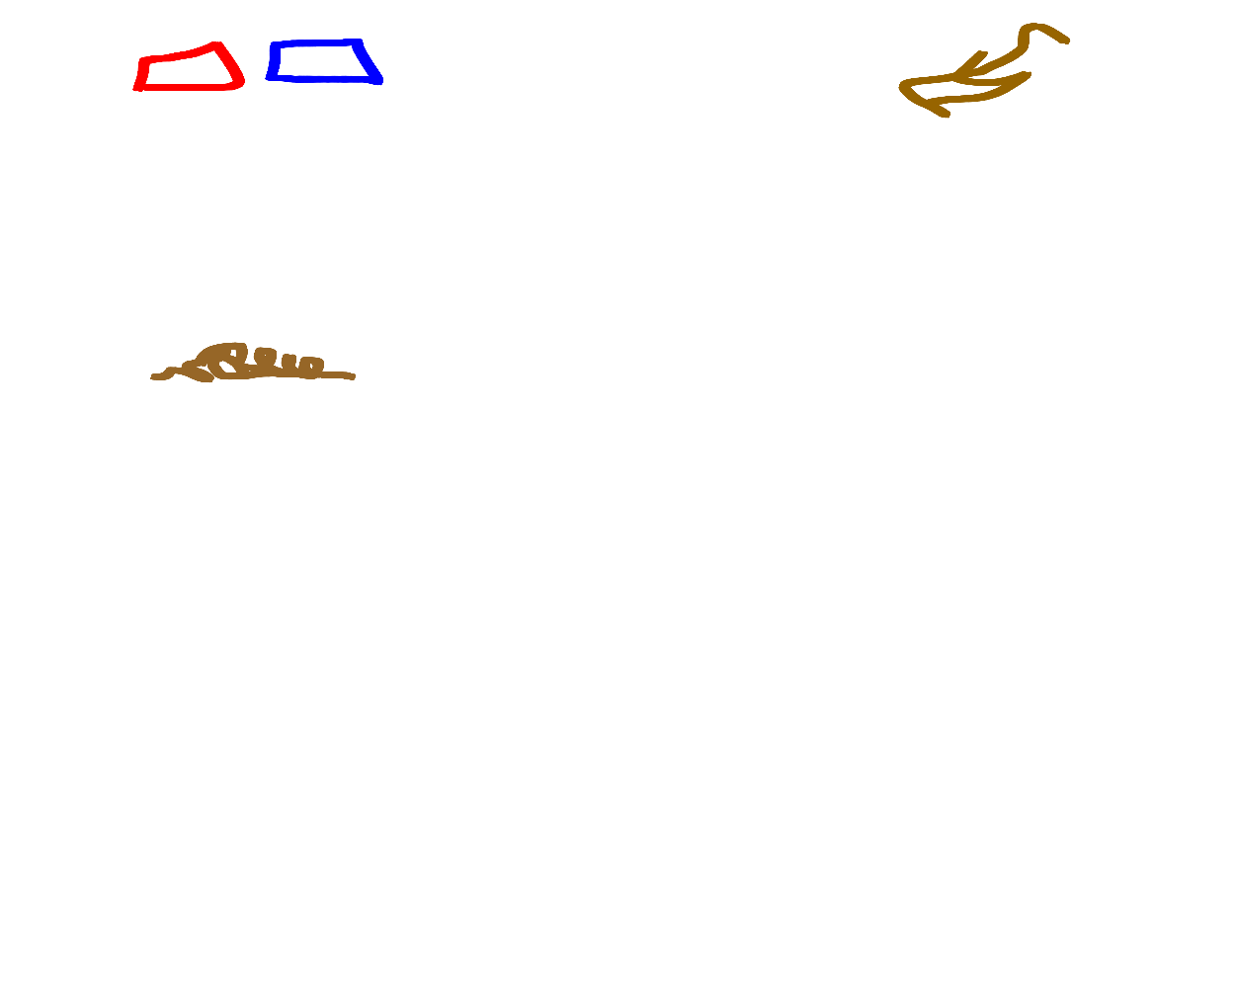
Complex Counterfactual Reasoning at 6-8 years
See Rafetseder et al. (2013) for ambiguous case
Cases:
Ambiguous causes (n/a)
“A and B went in together”
vs.
Unrelated causes (6 < )
“A and B went in separately”
Connected causes (6 < )
“A told B to tell C”
vs.
Disconnected causes (8 < )
“A and B both told C”
Nyhout et al. (2019)

Slide 9
Modelling Modal Thought

Slide 10
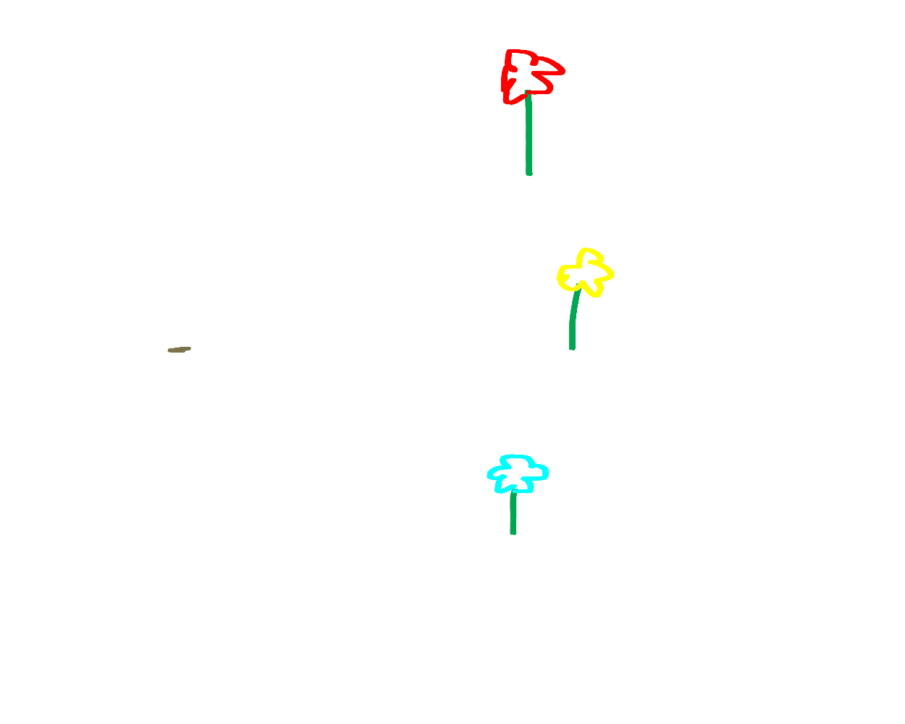
Generating possibilities: a Decomposed Unified Framework
(Philips & Kratzer, 2022)
Domain Projection
A cognitive function that inputs anchors and outputs its possibilities in the future.
Factuality-directed domain projection for real world thought.
Inverted domain projection outputs possible events from the anchors past.
Anchors
Class of objects that represents a situation.
Actual anchors are based on situations in the real world.
Epistemic anchors are based on beliefs.

Slide 11

Reasoning through: Structural Causal Models
Structured in a directed acyclic graphs.
Situations are nodes and connections are causal relationships.
(Pearl, 2009)
Changes from a counterfactual are followed unidirectionally (past to future)
(Hiddleston, 2009)
Changes from a counterfactuals are followed by bidirectionally

Slide 12
Reference
Alderete, S., & Xu, F. (2023). Three-year-old children’s reasoning about possibilities. Cognition, 237, 105472. https://doi.org/10.1016/j.cognition.2023.105472
Grigoroglou, M., Chan, S., & Ganea, P. A. (2019). Toddlers’ understanding and use of verbal negation in inferential reasoning search tasks. Journal of Experimental Child Psychology, 183, 222–241. https://doi.org/10.1016/j.jecp.2019.02.004
Harris, P. L., German, T., & Mills, P. (1996). Children’s use of counterfactual thinking in causal reasoning. Cognition, 61(3), 233–259. https://doi.org/10.1016/S0010-0277(96)00715-9
Hiddleston, E. (2005). A Causal Theory of Counterfactuals. Noûs, 39(4), 632–657. https://doi.org/10.1111/j.0029-4624.2005.00542.x
Nyhout, A., Henke, L., & Ganea, P. A. (2019). Children’s Counterfactual Reasoning About Causally Overdetermined Events. Child Development, 90(2), 610–622. https://doi.org/10.1111/cdev.12913
Pearl, J. (2009). Causality (2nd ed.). Cambridge University Press. https://doi.org/10.1017/CBO9780511803161
Phillips, J. S., & Kratzer, A. (2022). Decomposing modal thought. OSF. https://doi.org/10.31234/osf.io/g6tzc
Rafetseder, E., Schwitalla, M., & Perner, J. (2013). Counterfactual reasoning: From childhood to adulthood. Journal of Experimental Child Psychology, 114(3), 389. https://doi.org/10.1016/j.jecp.2012.10.010
Téglás, E., Girotto, V., Gonzalez, M., & Bonatti, L. L. (2007). Intuitions of probabilities shape expectations about the future at 12 months and beyond. Proceedings of the National Academy of Sciences, 104(48), 19156–19159. https://doi.org/10.1073/pnas.0700271104

